Slide 1
Prediction of Adult Income
Sara Maxwell

Slide 2
Problem
Various factors determine an individual adult’s income.
Education level
Age
Gender
Field of work

Slide 3
About the Data
Comes from the UC Irvine repository
Collected in 1996: https://www.kaggle.com/wenruliu/adult-income-dataset
14 variables about attributes from 48,842 individuals
Information: http://www.cs.toronto.edu/~delve/data/adult/adultDetail.html

Slide 4
Overview
The steps involved in this analysis include:
Data cleaning and wrangling
Feature engineering
Preprocessing: scaling, one-hot encoding
Exploratory data analysis
Machine learning

Slide 5
Steps in the Analysis
Data Cleaning
Remove rows with missing values (shown as “?”)
New binary column for income (greater than $50K or not)
Remove columns not necessary for analysis
Preprocessing
Scaling
One-hot encoding

Slide 6
Steps in the Analysis (cont.)
Exploratory Data Analysis
Calculate proportions of incomes over $50K
Education
WorkClass
Occupation
Marital Status
Relationship
Race
Gender

Slide 7
Steps in the Analysis (cont.)
Machine Learning
Use test-train splits
Logistic Regression
Decision Tree
Random Forest

Slide 8
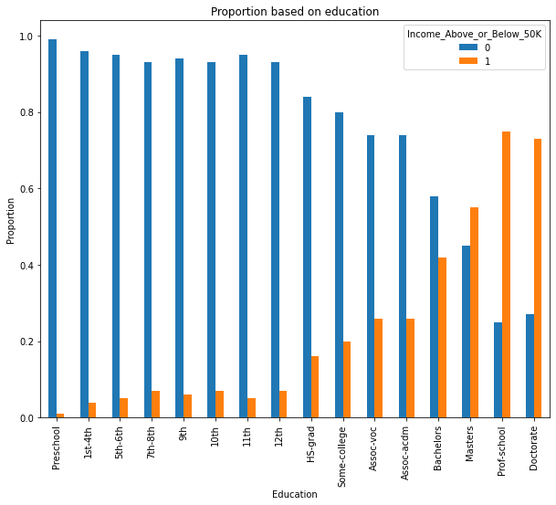
Exploratory Data Analysis
As expected, the higher the education level, the greater the proportion of adults with incomes over 50K. From the master's level and up, adults making more than 50K outnumber adults making 50K or less.

Slide 9
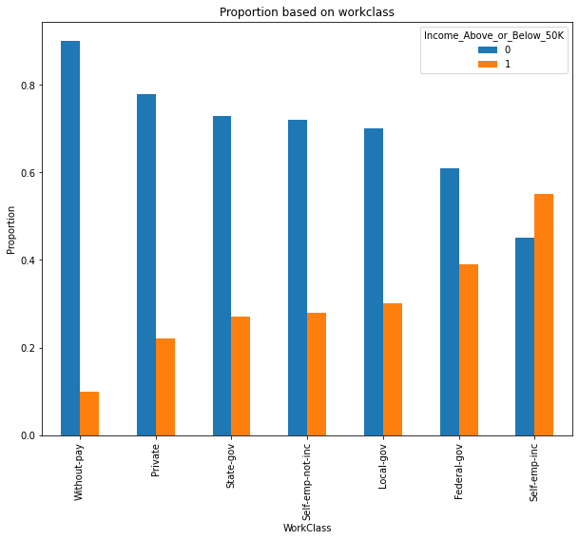
Exploratory Data Analysis (cont.)
Among the adults with pay, those in the private class have the lowest proportion of incomes over 50K, while those self-employed in incorporated businesses have not only the greatest proportion of incomes over 50K, but adults making more than 50K outnumber those that are not.

Slide 10
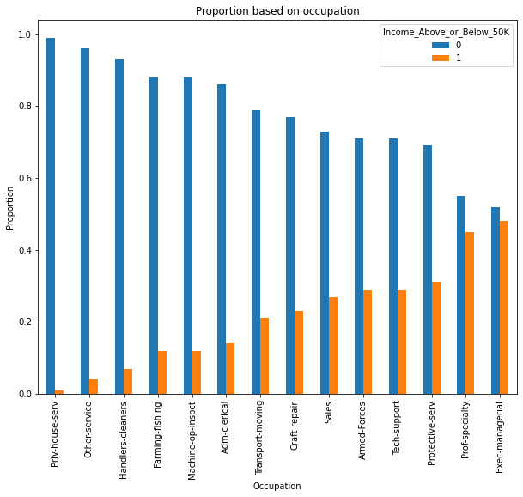
Exploratory Data Analysis (cont.)
All occupations have more adults with incomes $50K or less than adults with greater incomes. The difference is least with executive managerial positions, followed closely by specialized professionals such as doctors and lawyers.

Slide 11
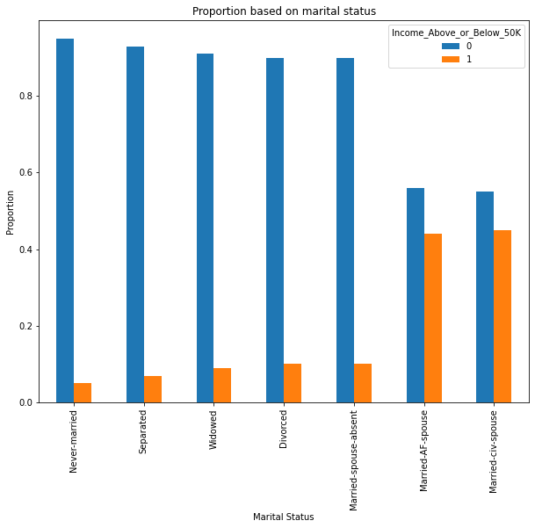
Exploratory Data Analysis (cont.)
All categories have more adults with incomes of 50K or less than adults with incomes over 50K, but the gap is much smaller with married couples that have a spouse present.

Slide 12
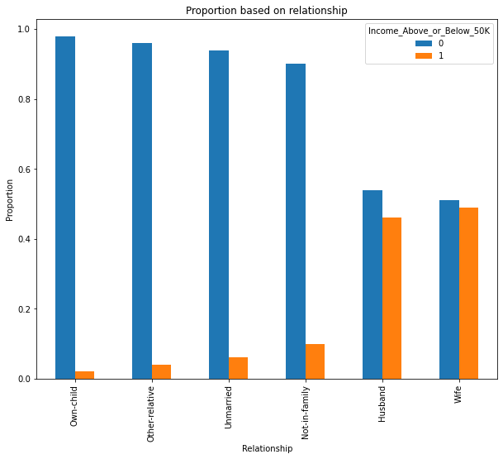
Exploratory Data Analysis (cont.)
All categories have more adults with incomes of 50K or less than adults with incomes over 50K, but the gap is much smaller with husbands and wives. This makes sense because of similarly small gaps in the categories of married couples with the spouse present.

Slide 13
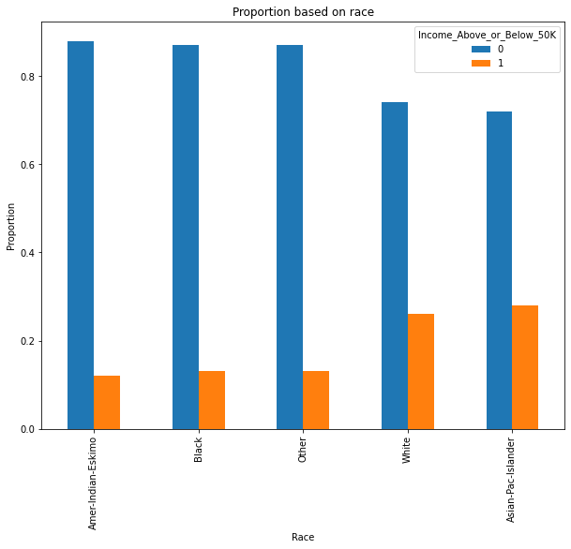
Exploratory Data Analysis (cont.)
Whites and Asians have higher proportions of incomes over $50K.

Slide 14
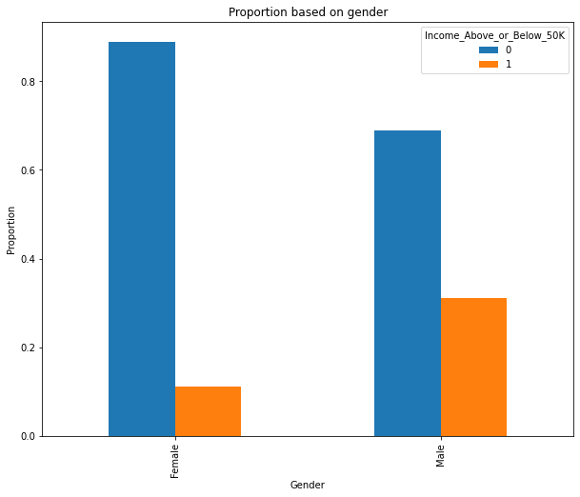
Exploratory Data Analysis (cont.)
Men have a higher proportion of incomes over $50K.

Slide 15
Machine Learning
Comparing different regression models:
Logistic Regression
Accuracy: 0.8398
Decision Tree (entropy)
Accuracy: 0.7891
Balanced accuracy: 0.7057
Precision: 0.5813
Recall: 0.5399
F-measure: 0.5598

Slide 16
Machine Learning (cont.)
Decision Tree (gini)
Accuracy: 0.7869
Balanced accuracy: 0.7045
Precision: 0.5757
Recall: 0.5406
F-measure: 0.5576

Slide 17
Machine Learning (cont.)
Random Forest (entropy)
Accuracy: 0.8162
Balanced accuracy: 0.7314
Precision: 0.6501
Recall: 0.563
F-measure: 0.6034

Slide 18
Machine Learning (cont.)
Random Forest (gini)
Accuracy: 0.8143
Balanced accuracy: 0.7277
Precision: 0.647
Recall: 0.5556
F-measure: 0.5978

Slide 19
Conclusions
Random Forest Entropy has the highest precision, recall, and F-score
Logistic Regression model has highest accuracy
Most important factors:
Married in a civil procedure
Being a husband
Never-married

Slide 20
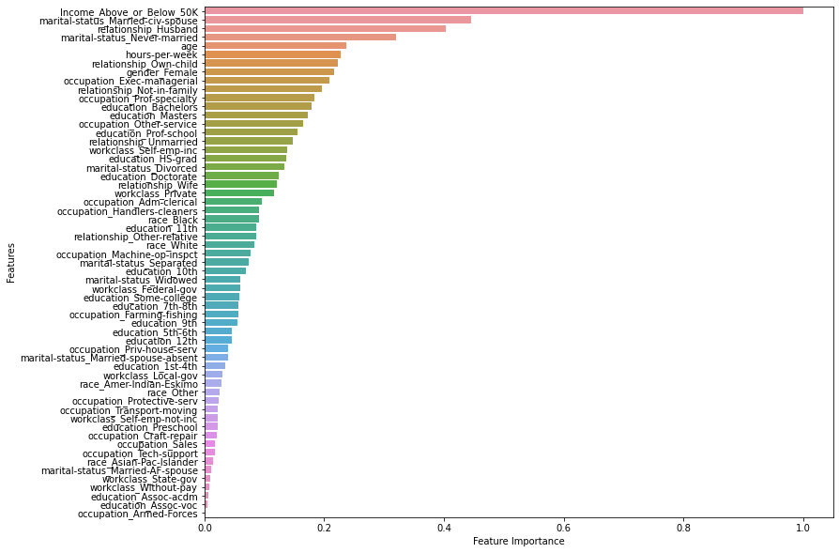
Conclusions (cont.)
The highest importance value, civil marriage, is 0.446, so the importance of each individual factor is not that strong.

Slide 21
Future Recommendations
The dataset is from 1996, so more recent data may help
Data with actual income values, not just a comparison to one value

